Slide 1
Probabilities and Language Models
Prof. Chris Callison-Burch

Slide 2
Probabilities and Language Models
Review the basics of probability theory
﻿﻿Axioms of probability
What an event is
What a probabilistic model is
﻿﻿Interactions between joint probabilities, conditional probabilities, marginal distributions
﻿﻿The chain rule
﻿﻿Bayes rule
﻿﻿Performing probabilistic inference
﻿﻿Probabilistic language models
Using a new textbook for this section.

Slide 3
Review of Probabilities

Slide 4

Uncertainty
General situation:
Observed variables (evidence): Agent knows certain things about the state of the world (e.g., sensor readings or symptoms)
Unobserved variables (states): Agent needs to reason about other aspects (e.g. where an object is or what disease is present)
Model: Agent knows something about how the known variables relate to the unknown variables
Probabilistic reasoning gives us a framework for managing our beliefs and knowledge

Slide 5
What Probabilities Are About
Like logical assertions, probabilities are about possible worlds. Instead of strictly ruling out possibilities (where a logical assertion is false), probabilities quantify how likely a particular possible world is.
In probability theory, the possible worlds are called the sample space, and they mutually exclusive and exhaustive.
A fully specified probability model associates a probability P(𝑤) with each possible world 𝑤.

Slide 6

Random Variables
A random variable is some aspect of the world about which we (may) have uncertainty
R = Is it raining?
U = Is the professor carrying an umbrella?
We denote random variables with capital letters
Notes:
We are going to deal with discrete random variables, rather than continuous ones. In continuous you deal with integrals rather than summations.

Slide 7
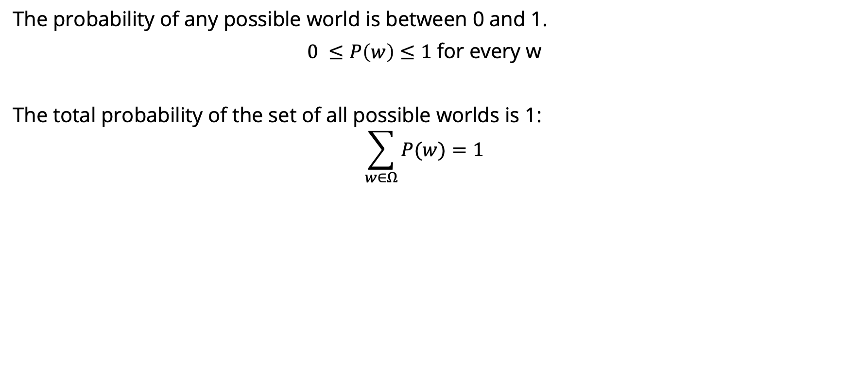
Axioms of Probability

Slide 8
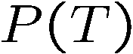
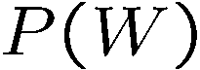

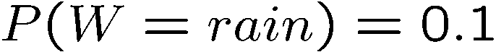
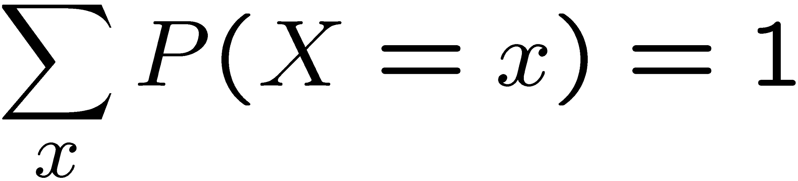
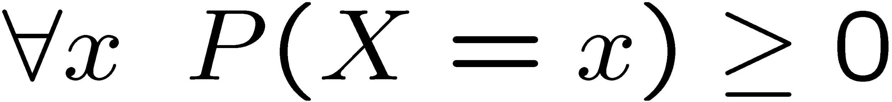
Probability Distributions
Unobserved random variables have distributions
A distribution is a TABLE of probabilities of values
A probability (lower case value) is a single number
Must have: and
Shorthand notation:
OK if all domain entries are unique
T | P
hot | 0.5
cold | 0.5
W | P
sun | 0.6
rain | 0.1
fog | 0.3

Slide 9
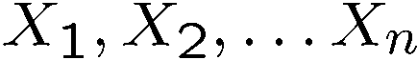
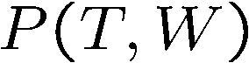
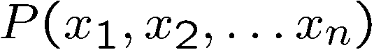
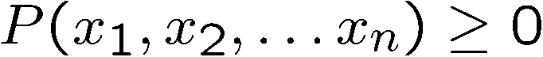
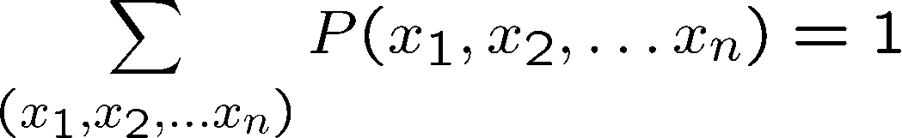
Joint Distributions
A joint distribution over a set of random variables:
specifies a real number for each assignment (or outcome):
Must obey:
Size of distribution if n variables with domain sizes d?
For all but the smallest distributions, impractical to write out!
T | W | P
hot | sun | 0.4
hot | rain | 0.1
cold | sun | 0.2
cold | rain | 0.3
Notes:
N*D? No.
D^N? Yes.
In the next lectures we’re going to see how to work with how to deal with large sets of variables.

Slide 10
Probabilistic Models
Distribution over T,W
A probabilistic model is a joint distribution over a set of random variables
Probabilistic models:
(Random) variables with domains
Assignments are called outcomes
Joint distributions: say whether assignments (outcomes) are likely
Normalized: sum to 1.0
Ideally: only certain variables directly interact
T | W | P
hot | sun | 0.4
hot | rain | 0.1
cold | sun | 0.2
cold | rain | 0.3

Slide 11
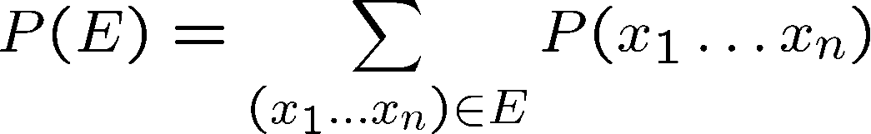
Events
An event is a set E of outcomes
From a joint distribution, we can calculate the probability of any event
Probability that it’s hot AND sunny?
Probability that it’s hot?
Probability that it’s hot OR sunny?
Typically, the events we care about are partial assignments, like P(T=hot)
T | W | P
hot | sun | 0.4
hot | rain | 0.1
cold | sun | 0.2
cold | rain | 0.3
Notes:
An event is a set of possible outcomes. We compute these by summing over all subsets of variables that are compatible with that event. These are subsets of variables.
Let’s say x1=true, then if you sum over all entries in the joint table with x1…xN, where the entry says x=1 is true then you get the probability that x=1 true.
Events don’t have to be as simple as x1=true. It could be x1=true and x2=false. Or more combinations of variables coule be involved.
Look at all of the entries that are consistent with the event.
Probability that it’s hot AND sunny? 0.4
Probability that it’s hot? 0.5
Probability that it’s hot OR sunny? 0.8

Slide 12
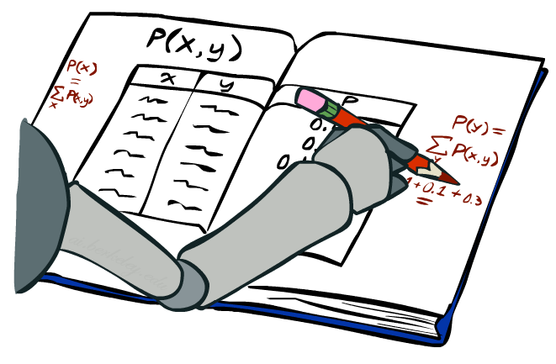
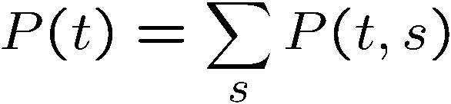
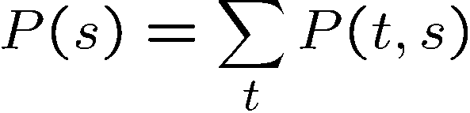
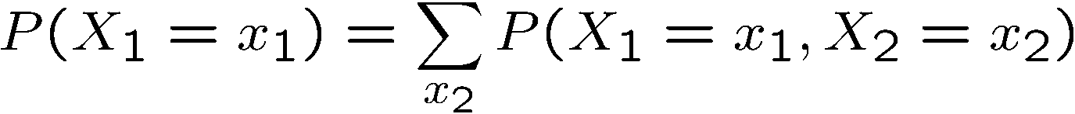
Marginal Distributions
Marginal distributions are sub-tables which eliminate variables
Marginalization (summing out): Combine collapsed rows by adding
T | P
hot | 0.5
cold | 0.5
T | W | P
hot | sun | 0.4
hot | rain | 0.1
cold | sun | 0.2
cold | rain | 0.3
W | P
sun | 0.6
rain | 0.4
Notes:
Marginalize distribution means you build a new table for a subset of random variables.
This is the general equation. You can apply it to any number of random variables. If you had 3 random varaibles, you could compute the marginals for
Just x1
Just x2
Just x3
x1 and x2
x2 and x3
x1 and x3

Slide 13
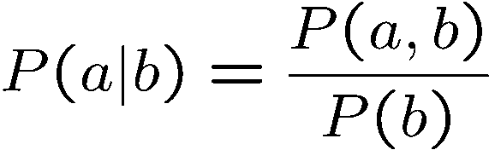
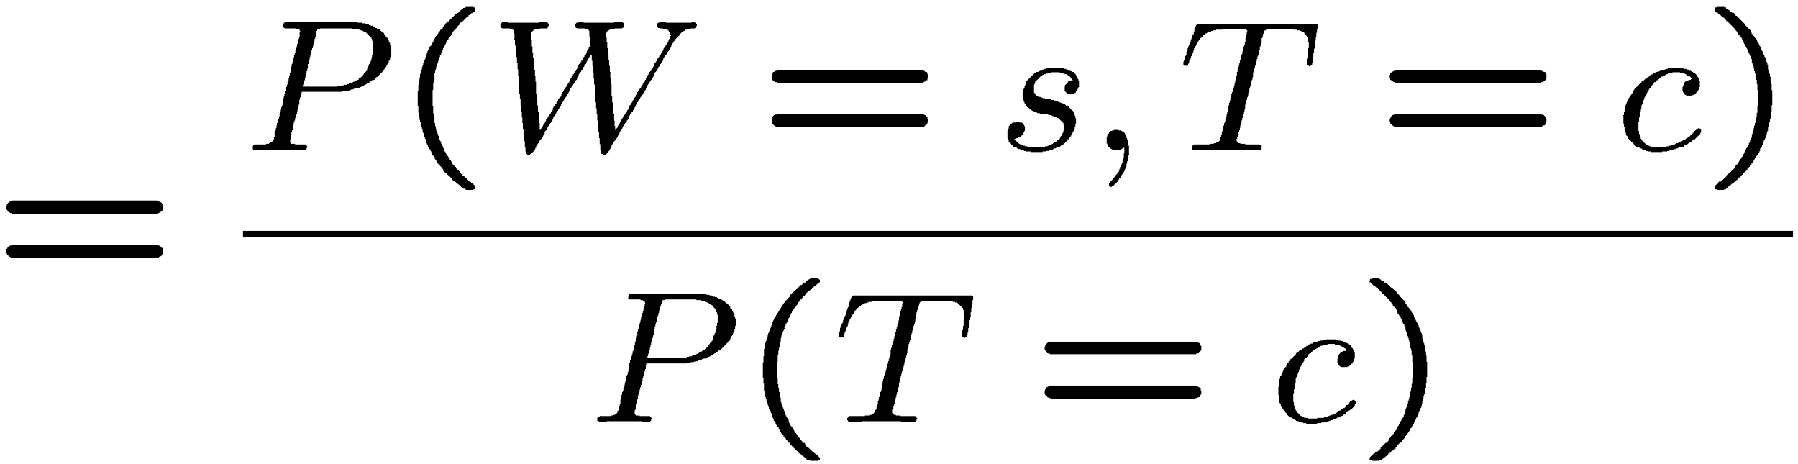
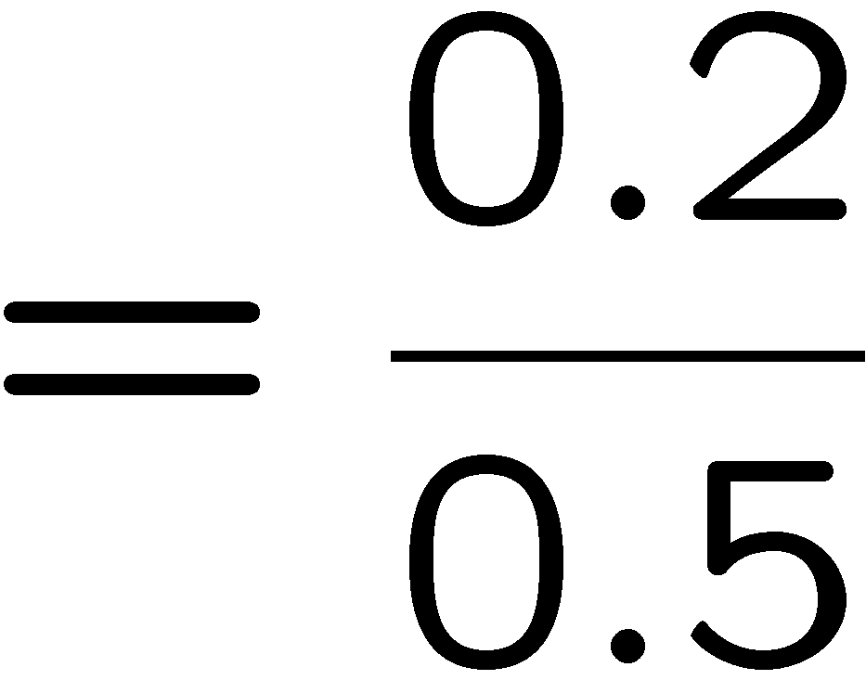



Conditional Probabilities
A simple relation between joint and conditional probabilities
In fact, this is taken as the definition of a conditional probability
P(a,b)
P(a)
P(b)
T | W | P
hot | sun | 0.4
hot | rain | 0.1
cold | sun | 0.2
cold | rain | 0.3
Notes:
This is the most important concept. Why because it tells us, if we measure something, what does it tell us about the things that we didn’t get to measure. That’s what conditional probabilities come in.
A conditional probability that random variable Capital A will take on value lowercase a, given that random variable Capital B takes on value lowercase b. This is given by the probability of seeing both a and b, divided by the probability of seeing b.
[Explain the Venn diagram.]
Write out the equation for P(sun|cold)

Slide 14
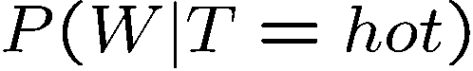
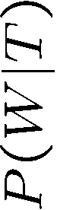
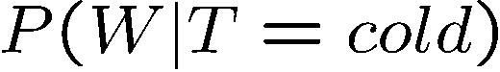
Conditional Distributions
Conditional distributions are probability distributions over some variables given fixed values of others
Conditional Distributions
Joint Distribution
W | P
sun | 0.8
rain | 0.2
T | W | P
hot | sun | 0.4
hot | rain | 0.1
cold | sun | 0.2
cold | rain | 0.3
W | P
sun | 0.4
rain | 0.6
Notes:
Before we saw how to go from a joint distribution to a marginal distribution. Now we’re going to see how to go from a joint distribution to a conditional.
A conditional distribution is a consequence of the joint distribution. We do that just like we did on the previous slide).
P(W|T) is a set of tables that can be extracted from the joint distribution P(T, W).

Slide 15

Probabilistic Inference
Probabilistic inference: compute a desired probability from other known probabilities (e.g. conditional from joint)
We generally compute conditional probabilities
P(on time | no reported accidents) = 0.90
These represent the agent’s beliefs given the evidence
Probabilities change with new evidence:
P(on time | no accidents, 5 a.m.) = 0.95
P(on time | no accidents, 5 a.m., raining) = 0.80
Observing new evidence causes beliefs to be updated
Notes:
What is probabilistic inference in general? It’s computing some desired probabilities (usually conditionals), given some input set of probabilities (by default, a large joint distribution).
The reason that this is interesting, is that our probability distributions change as we accrue more evidence.
Observing new evidence causes our beliefs to be updated. Evidence can cause the probabilities to go up or to go down.

Slide 16
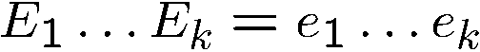
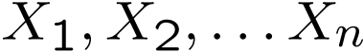
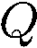
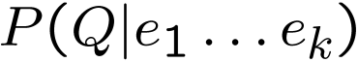
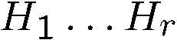
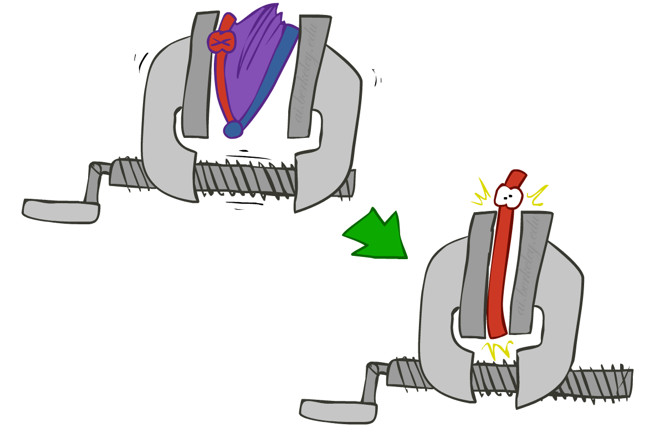
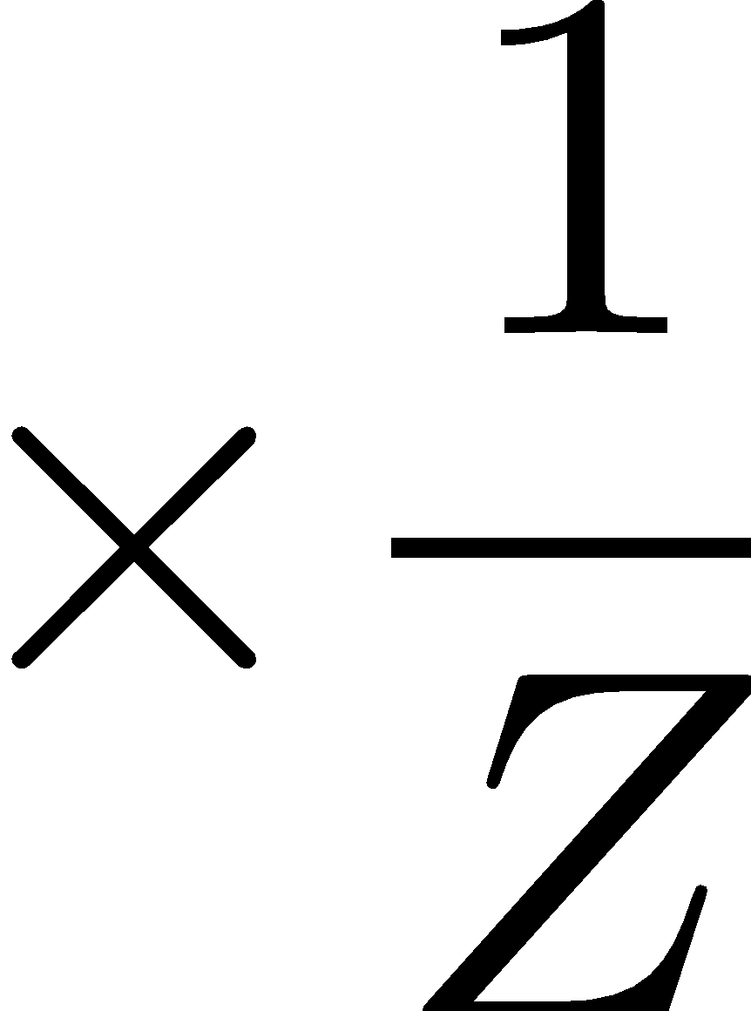
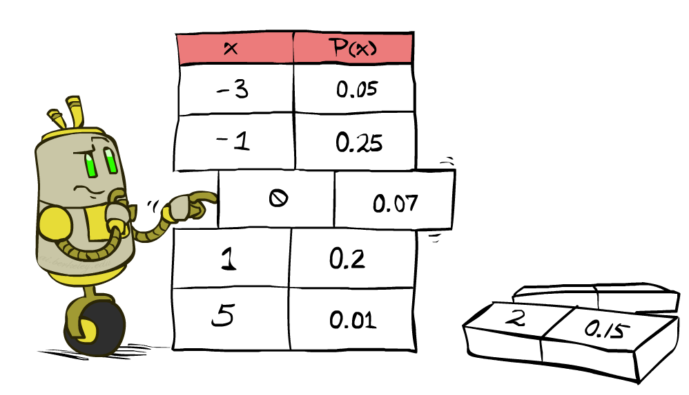
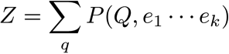
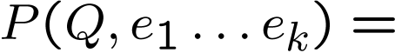
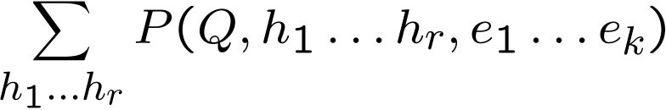
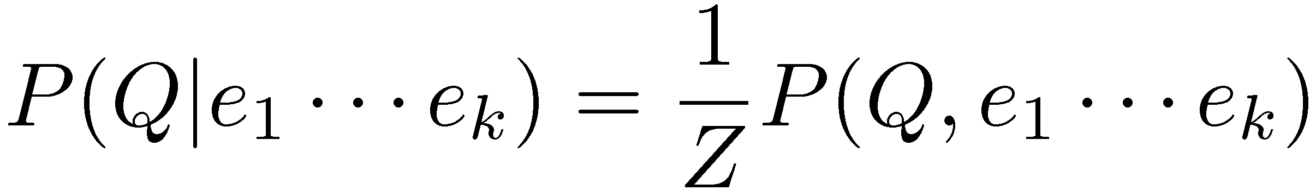
Inference by Enumeration
* Works fine with multiple query variables, too
General case:
Evidence variables:
Query* variable:
Hidden variables:
We want:
All variables
Step 1: Select the entries consistent with the evidence
Step 2: Sum out H to get joint of Query and evidence
Step 3: Normalize
Notes:
Here’s the first procedure that we’ll look at for Probabilistic Inference. It is called Inference by Enumeration
We can split up our variables into 3 sets:
1. some evidence variables – those are what we’ve observed.
2. The query variables – those are what we want to know about
3. The hidden variables – those appear in the joint distribution, but don’t appear in the previous 2.
Here are the 3 steps that we need to do:
Step 1: select all entries that are consistent with the Evidence.
Step 2: Sum out the hidden variables. Sum over all possible instantiations of the hidden variables. That leaves us with the joint distribution between the query variable and the evidence variables.
That’s something like P(a, c) = sum over b P(a,b,c).
That’s the same as P(q, e) = sum over h P(q,h,e).
Step 3: Normalize to get the conditional probability.

Slide 17
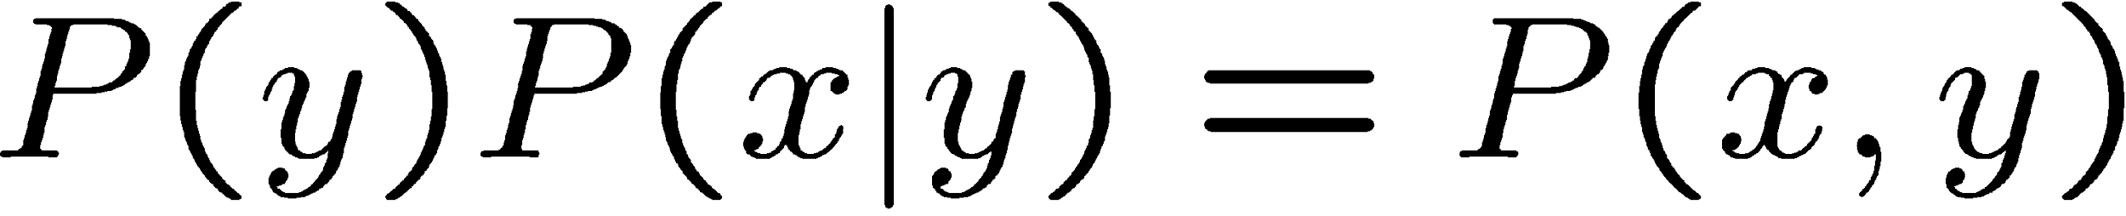
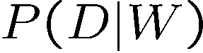
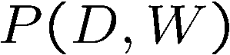
The Product Rule
Example:
D | W | P
wet | sun | 0.1
dry | sun | 0.9
wet | rain | 0.7
dry | rain | 0.3
D | W | P
wet | sun | 0.08
dry | sun | 0.72
wet | rain | 0.14
dry | rain | 0.06
R | P
sun | 0.8
rain | 0.2
Notes:
How do recover the full joint distribution?
P(wet, sun) =. P(sun) * P(wet | sun) = 0.8 * 0.1 = 0.08
P(dry, sun) =. P(sun) * P(dry| sun) = 0.8 * 0.9 = 0.72
P(wet, rain) = P(rain) * P(wet | rain) = 0.2 * 0.7 = 0.14 P(dry, rain) = P(rain) * P(dry | train) = 0.2 * 0.3 = 0.06
…
We can compute every entry that way.

Slide 18
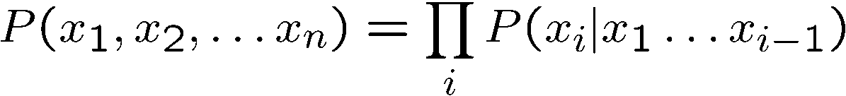
The Chain Rule
More generally, can always write any joint distribution as an incremental product of conditional distributions
Why is this always true?
Notes:
Can we apply the product rule to more than two variables? Yes! It’s called the chain rule.
Here’s the chain rule for 3 variables, x1, x2, x3. It’s the maginal of x1, times the conditional of x2 given x1, times the conditional of x3 given x1 and x2.
We can generalize this to any number of x1 to x_n as ….
i = 1 P(x1)
I = 2 p(x2|x1)
I = 3 p(x3|x1, x2)
…
I = n p(x_n|x1, x2, …. Xn-1)
Then you take the product of all of those. You can take any ordering and still apply this chain rule. There are n! ways of writing the joint over the ordering of n variables.
Why is this always true? [Write out the equations for P(x1,x2,x3) replacing each conditional with its joint over marginal equivalent and show how the cancel.).
P(x1) * P(x2|x1) * p(x3|x2,x1) rewrites as P(x1) * P(x2,x1)/P(x1) * p(x3,x2,x1)/p(x2,x1).
Show the cancelation of each numerator and the next term’s denominator.
That leaves p(x3,x2,x1).
If you want, you can prove this by induction.

Slide 19
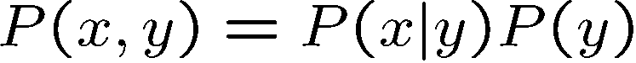
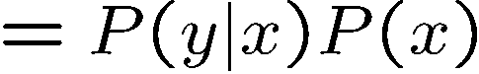
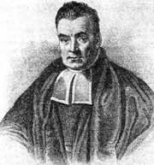
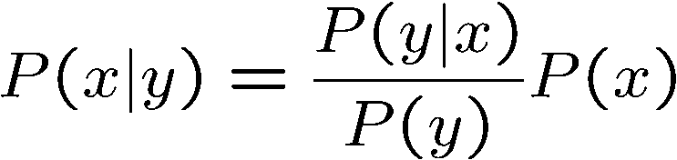
Bayes’ Rule
Two ways to factor a joint distribution over two variables:
Dividing, we get:
Why is this at all helpful?
Lets us build one conditional from its reverse
Often one conditional is tricky but the other one is simple
Foundation of many systems we’ll see later (e.g. ASR, MT)
In the running for most important AI equation!
Notes:
We start with the product rule. Just like the chain rule you can write the variables in any order.
Next we divide by p(y) to get this formula for the conditional probability.
Why is this helpful? Sometimes one conditional is much trickier to get than it is to get other conditionals.
Very imporant for AI in the 1990s. In fact Fred Jelinek, my former boss at JHU, dubbed it the fundamental equation of machine translation.
Generalizations of this will be what we study in the next few lectures.

Slide 20

https://www.youtube.com/watch?v=M8MJFrdfGe0
Notes:
https://www.youtube.com/watch?v=M8MJFrdfGe0

Slide 21

https://www.youtube.com/watch?v=WVF3q5Y68-0
Notes:
https://www.youtube.com/watch?v=M8MJFrdfGe0

Slide 22
Probabilistic Language Models

Slide 23
Probabilistic Language Models
One goal: assign a probability to a sentence
Another goal: predict the most likely next word given some context
Autocomplete for texting
Machine Translation
Spelling Correction
Speech Recognition
ChatGPT
Other Natural Language Generation tasks: summarization, question-answering, dialog systems
Notes:
minuet = a slow, stately ballroom dance

Slide 24
Probabilistic Language Modeling
Goal: compute the probability of a sentence or sequence of words
Related task: probability of an upcoming word
A model that computes either of these is called a language model or LM

Slide 25
Probabilistic Language Modeling
Goal: compute the probability of a sentence or sequence of words
P(W) = P(w₁,w₂,w₃,w₄,w₅…w_{n})
Related task: probability of an upcoming word
P(w₅|w₁,w₂,w₃,w₄)
A model that computes either of these
P(W) or P(w_{n}|w₁,w₂…w_{n-1}) is called a language model or LM.
Better: the grammar But language models are standard

Slide 26
How to compute P(W)
How to compute this joint probability:
P(the, underdog, Philadelphia, Phillies, won)
Intuition: let’s rely on the Chain Rule of Probability

Slide 27
The Chain Rule

Slide 28
The Chain Rule
Recall the definition of conditional probabilities
p(B|A) = P(A,B)/P(A) Rewriting: P(A,B) = P(A)P(B|A)
More variables:
P(A,B,C,D) = P(A)P(B|A)P(C|A,B)P(D|A,B,C)
The Chain Rule in General
P(x₁,x₂,x₃,…,x_{n}) = P(x₁)P(x₂|x₁)P(x₃|x₁,x₂)…P(x_{n}|x₁,…,x_{n-1})

Slide 29
Joint probability of words in sentence

Slide 30
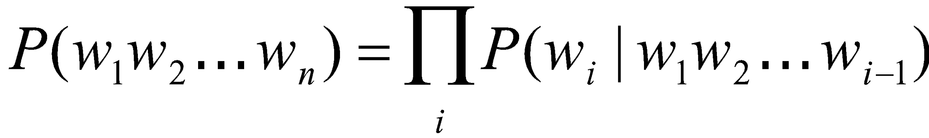
Joint probability of words in sentence
P(“the underdog Philadelphia Phillies won”) =
P(the) × P(underdog|the) × P(Philadelphia|the underdog) × P(Phillies|the underdog Philadelphia) x P(won|the underdog Philadelphia Phillies)

Slide 31
How to estimate these probabilities
Could we just count and divide?

Slide 32
How to estimate these probabilities
Could we just count and divide? Maximum likelihood estimation (MLE)
Why doesn’t this work? Why is it not practical?
P(won|the underdog team) = Count(the underdog team won)
Count(the underdog team)
Notes:
Sentences may not appear
Need a lrage data set
Many ways of combining words into sentences
Never going to have enough data to estimate the probability of a whole sentence

Slide 33
Simplifying Assumption = Markov Assumption

Slide 34
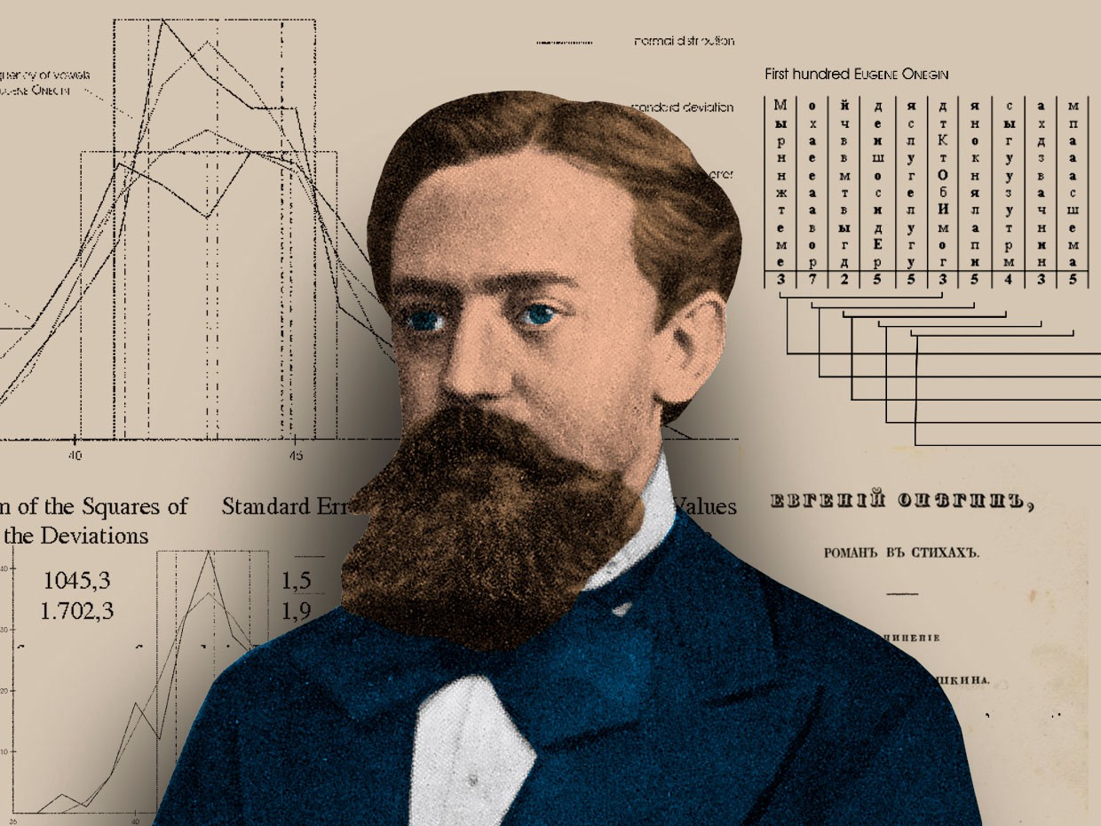
Historical Notes
1913 | Andrei Markov counts 20k letters in Eugene Onegin
1948 | Claude Shannon uses n-grams to approximate English
1956 | Noam Chomsky decries finite-state Markov Models
1980s | Fred Jelinek at IBM TJ Watson uses n-grams for ASR, think about 2 other ideas for models: (1) MT, (2) stock market prediction
1993 | Jelinek and team develops statistical machine translation argmax_e p(e|f) = p(e) p(f|e)
 | Jelinek left IBM to found CLSP at JHU Peter Brown and Robert Mercer move to Renaissance Technology
Andrei Markov
Notes:
In a series of extremely influential papers starting with Chomsky (1956) and including Chomsky (1957) and Miller and Chomsky (1963), Noam Chomsky argued that “finite-state Markov processes”, while a possibly useful engineering heuristic, were incapable of being a complete cognitive model of human grammatical knowl- edge. These arguments led many linguists and computational linguists to ignore work in statistical modeling for decades.

Slide 35
Language Modeling
No instructor’s office hours this Monday – I’ll be at the OpenAI Developers’ Conference.
Estimating N-gram Probabilities

Slide 36
Joint probability of words in sentence
P(“the underdog Philadelphia Phillies won”) =
P(the) × P(underdog|the) × P(Philadelphia|the underdog) × P(Phillies|the underdog Philadelphia) x P(won|the underdog Philadelphia Phillies)

Slide 37
How to estimate these probabilities
Could we just count and divide? Maximum likelihood estimation (MLE)
Why doesn’t this work? Why is it not practical?
P(won|the underdog team) = Count(the underdog team won)
Count(the underdog team)
Notes:
Sentences may not appear
Need a lrage data set
Many ways of combining words into sentences
Never going to have enough data to estimate the probability of a whole sentence

Slide 38
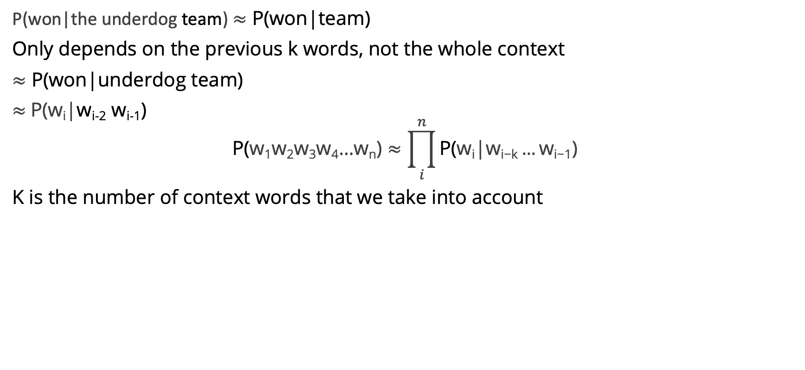
Simplifying Assumption = Markov Assumption

Slide 39
N-gram models use limited history
Model | History
unigram | no history
bigram | 1 word as history
trigram | 2 words as history
4-gram | 3 words as history

Slide 40
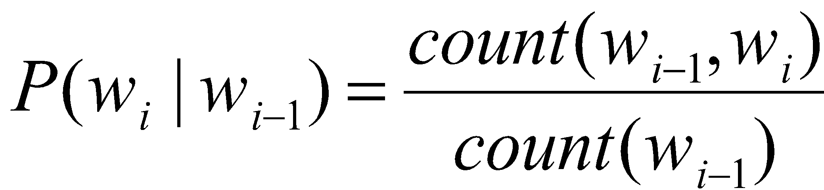
Estimating bigram probabilities
The Maximum Likelihood Estimate

Slide 41
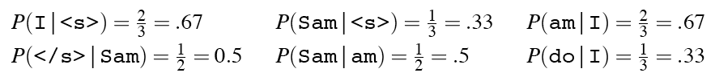
A Worked Example
<s> I am Sam </s>
<s> Sam I am </s>
<s> I do not like green eggs and ham </s>

Slide 42
N-gram models use limited history
unigram | no history
bigram | 1 word as history
trigram | 2 words as history
4-gram | 3 words as history

Slide 43
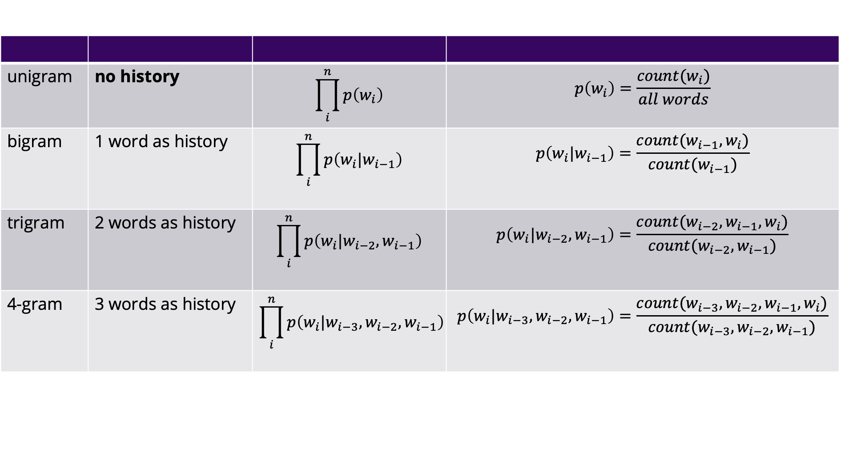
N-gram models use limited history
unigram | no history | $$\prod_{i}^{n}{p\left(w_{i}\right)}$$ | $$p\left(w_{i}\right)=\frac{count(w_{i})}{all words}$$
bigram | 1 word as history | $$\prod_{i}^{n}{p\left(w_{i}|w_{i−1}\right)}$$ | $$p\left(w_{i}|w_{i−1}\right)=\frac{count(w_{i−1},w_{i})}{count(w_{i−1})}$$
trigram | 2 words as history | $$\prod_{i}^{n}{p\left(w_{i}|w_{i−2},w_{i−1}\right)}$$ | $$p\left(w_{i}|w_{i−2},w_{i−1}\right)=\frac{count(w_{i−2}, w_{i−1},w_{i})}{count(w_{i−2}, w_{i−1})}$$
4-gram | 3 words as history | $$\prod_{i}^{n}{p\left(w_{i}|w_{i−3},w_{i−2},w_{i−1}\right)}$$ | $$p\left(w_{i}|w_{i−3},w_{i−2},w_{i−1}\right)=\frac{count(w_{i−3}, w_{i−2}, w_{i−1},w_{i})}{count(w_{i−3},w_{i−2}, w_{i−1})}$$

Slide 44
N-gram models versus long distance dependencies
We can extend to trigrams, 4-grams, 5-grams
In general, this is an insufficient model of language
Because languages have long distance dependencies
The pictures are beautiful. The pictures of the old man are beautiful. The pictures of the old man holding his grandchild are beautiful.

Slide 45
Problems for MLE
Zeros
P(memo|denied the) = 0
And we also assign 0 probability to all sentences containing it!
Train | Test
denied the allegations | denied the memo
denied the reports
denied the claims
denied the requests

Slide 46
Problems for MLE
Out of vocabulary items (OOV)
<unk> to deal with OOVs
Fixed lexicon L of size V
Normalize training data by replacing any word not in L with <unk>
Avoid zeros with smoothing

Slide 47
Practical Issues
We do everything in log space
Avoid underflow
(also adding is faster than multiplying)

Slide 48
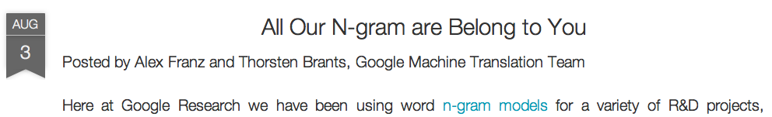
Google N-Gram Release, August 2006
…

Slide 49
Google N-Gram Release
serve as the incoming 92
serve as the incubator 99
serve as the independent 794
serve as the index 223
serve as the indication 72
serve as the indicator 120
serve as the indicators 45
serve as the indispensable 111
serve as the indispensible 40
serve as the individual 234
https://ai.googleblog.com/2006/08/all-our-n-gram-are-belong-to-you.html

Slide 50
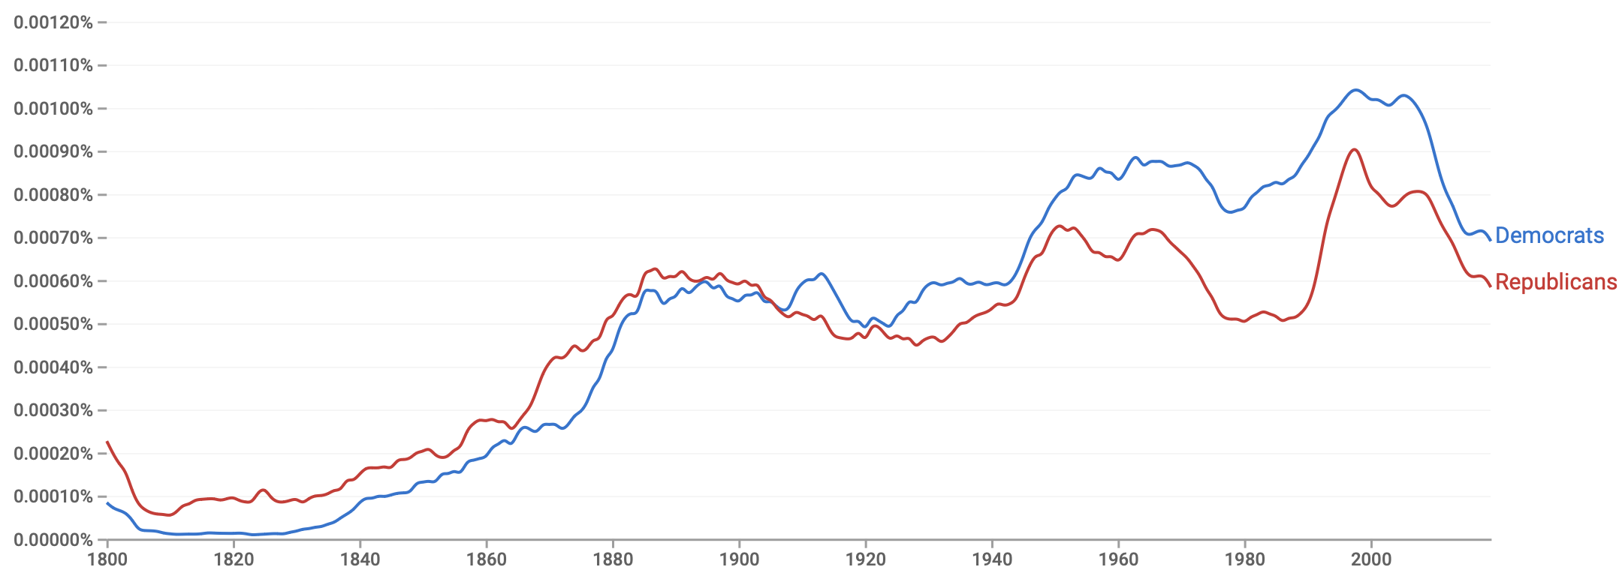
Google Book N-Grams
https://books.google.com/ngrams

Slide 51
Evaluation and Perplexity

Slide 52
Evaluation: How Good is Our Model
Does our language model prefer good sentences to bad ones?
Assign higher probability to “real” or “frequently observed” sentences
Than “ungrammatical” or “rarely observed” sentences?
We train parameters of our model on a training set.
We test the model’s performance on data we haven’t seen.
A test set is an unseen dataset that is different from our training set, totally unused.
An evaluation metric tells us how well our model does on the test set.

Slide 53
Training on the Test Set
We can’t allow test sentences into the training set
We will assign it an artificially high probability when we set it in the test set
“Training on the test set”
Bad science!
And violates the honor code

Slide 54
Extrinsic Evaluation of Language Models

Slide 55
Difficulty of extrinsic (task-based) evaluation of LMs
Extrinsic evaluation
Time-consuming; can take days or weeks
So
Sometimes use intrinsic evaluation: perplexity
Bad approximation
unless the test data looks just like the training data
So generally only useful in pilot experiments
But is helpful to think about

Slide 56
Intuition of Perplexity
The Shannon Game:
How well can we predict the next word?

Slide 57
Intuition of Perplexity
The Shannon Game:
How well can we predict the next word?
mushrooms 0.1
pepperoni 0.1
anchovies 0.01
….
fried rice 0.0001
….
and 1e-100
I always order pizza with cheese and ____

Slide 58
Intuition of Perplexity
The Shannon Game:
How well can we predict the next word?
Unigram models are terrible at this game. (Why?)
I always order pizza with cheese and ____
The 33rd President of the US was ____
I saw a ____

Slide 59
Intuition of Perplexity
The Shannon Game:
How well can we predict the next word?
Unigram models are terrible at this game. (Why?)
A better model of a text
is one that assigns a higher probability to the word that actually occurs
I always order pizza with cheese and ____
The 33rd President of the US was ____
I saw a ____

Slide 60



Perplexity
The best language model is one that best predicts an unseen test set
Gives the highest P(sentence)
Perplexity is the inverse probability of the test set, normalized by the number of words
Minimizing perplexity is the same as maximizing probability
$$PP\left(W\right)=P{\left(w_{1}w_{2}⋯w_{N}\right)}^{−\frac{1}{N}}$$
$$= \sqrt[N]{\frac{1}{P\left(w_{1}w_{2}⋯w_{N}\right)}}$$
$$PP\left(W\right)= \sqrt[N]{\prod_{i=1}^{N}{\frac{1}{P\left(w_{i}|w_{1},w_{2}⋯w_{i−1}\right)}}}$$
Chain rule
$$PP\left(W\right)= \sqrt[N]{\prod_{i=1}^{N}{\frac{1}{P\left(w_{i}|w_{i−1}\right)}}}$$
For bigrams
Notes:
Certainly! Perplexity is a measure used in statistical language modeling to gauge how well a probability model predicts a sample. It is a commonly used metric in natural language processing (NLP) to evaluate language models. A lower perplexity score indicates that the model is better at predicting the sample.
Now, let’s break down the formula you provided to make it easier to understand:
PP(W)=P(w1w2…wN)(−1/N)PP(W)=P(w1​w2​…wN​)(−1/N)
Here,
PP(W)PP(W) is the perplexity of the sequence of words WW,
P(w1w2…wN)P(w1​w2​…wN​) is the probability of the sequence of words WW according to the model,
NN is the number of words in the sequence.
The formula can be understood as taking the reciprocal of the geometric mean of the probability assigned to each word in the sequence by the model. The geometric mean is used as it's a more robust measure compared to arithmetic mean, especially when dealing with probabilities.
Perplexity measures the uncertainty of a probability model in predicting new data. A lower perplexity value indicates that the model is more certain (or less "perplexed") about its predictions, while a higher perplexity value indicates more uncertainty (or higher "perplexity").

Slide 61
Perplexity as branching factor
Let’s suppose a sentence consisting of random digits
What is the perplexity of this sentence according to a model that assign P=1/10 to each digit?
Notes:
Perplexity can be interpreted as the branching factor of a language model, which is the average number of choices the model thinks it has at each step in a sequence. In other words, it represents the average number of equally likely choices the model perceives it has when predicting the next element in a sequence. A lower perplexity indicates that the model has fewer "confusions" about what could come next, while a higher perplexity indicates more "confusions.”
Now, let’s calculate the perplexity for a sentence consisting only of random digits, according to a model that assigns P=1/10​ to each digit:
In this scenario, the model treats each digit (0 through 9) as equally likely at each position in the sequence. Given the formula for perplexity:
PP(W)=P(w1w2…wN)^(−1/N)
Let's assume the sentence has N digits. Since each digit is equally likely, the probability of the entire sentence is (1/10)^N. Plugging this into the formula, we get:
PP(W)=((1/10)^N)^(−1/N)
Simplifying this expression, we obtain:
PP(W)=1/10​^-1
=10
So, the perplexity of this sentence according to the model is 10, which makes intuitive sense. At each position in the sequence, the model has 10 equally likely choices (the digits 0 through 9), so the branching factor, or perplexity, is 10. This corresponds to the model’s uncertainty at each step of the sequence, reflecting the 10 possible digits that could appear next.

Slide 62

Perplexity as branching factor
Let’s suppose a sentence consisting of random digits
What is the perplexity of this sentence according to a model that assign P=1/10 to each digit?
$$\begin{aligned}PP\left(W\right)&=P{\left(w_{1}w_{2}⋯w_{N}\right)}^{−\frac{1}{N}} \\ &={{\left(\frac{1}{10}\right)}^{N}}^{−\frac{1}{N}} \\ &={\frac{1}{10}}^{−1} \\ &=10\end{aligned}$$

Slide 63
Lower perplexity = better model
Minimizing perplexity is the same as maximizing probability
Training 38 million words, test 1.5 million words, WSJ
N-gram Order | Unigram | Bigram | Trigram
Perplexity | 962 | 170 | 109

Slide 64
Generation
Generalization and zeros

Slide 65
Sampling from the distribution
Choose a random bigram (<s>, w) according to its probability
Now choose a random bigram (w, x) according to its probability
And so on until we choose </s>
Then string the words together
<s> I
I want
want to
to eat
eat Chinese
Chinese food
food </s>
I want to eat Chinese food

Slide 66

Notes:
If an infinite number of monkeys were set in front of typewriters and allowed to peck away at the keys for an infinite amount of time, they would eventually produce all possible finite text strings, including the complete works of Shakespeare.
The core ideas underlying this thought experiment include:
Randomness: The monkeys are pressing keys at random, without any intent or understanding.
Infinity: Given an infinite amount of time, or an infinite number of monkeys (or both), every possible combination of letters will eventually occur.
Probability: Despite the extraordinarily low probability of any particular sequence of letters occurring (such as the text of Shakespeare's "Hamlet"), given infinite chances, even events of vanishingly small probability will occur.
In the context of language generation:
The theorem can be used to illustrate the difference between random generation and meaningful generation. A language model aims to generate text that is coherent, meaningful, and contextually appropriate, whereas the monkeys are generating text purely at random.
It also highlights the importance of structure and patterns in language. Unlike random keystrokes, human language follows patterns and rules, which language models attempt to learn and replicate.

Slide 67

Approximating Shakespeare
Model | Generated Output
Unigram | –To him swallowed confess hear both. Which. Of save on trail for are ay device and rote life have –Hill he late speaks; or! a more to leg less first you enter
Bigram | –Why dost stand forth thy canopy, forsooth; he is this palpable hit the King Henry. Live king. Follow. –What means, sir. I confess she? then all sorts, he is trim, captain.
Trigram | –Fly, and will rid me these news of price. Therefore the sadness of parting, as they say, ’tis done. –This shall forbid it should be branded, if renown made it empty.
4-gram | –King Henry. What! I will go seek the traitor Gloucester. Exeunt some of the watch. A great banquet serv’d in; –It cannot be but so.

Slide 68
Approximating Shakespeare

Slide 69
Shakespeare as corpus
N=884,647 tokens, V=29,066 types
Notes:
V^2 = 844,000,000. What’s the maximum number of unique bigrams that Shakespeare produced, given 884k tokens? 884,647-1.
884,647/844,000,000 = 0.001 = He produced only 0.1% of possible bigrams.

Slide 70
Shakespeare as corpus
N=884,647 tokens, V=29,066 types
Shakespeare produced 300,000 bigram types out of V²= 844 million possible bigrams.
So 99.96% of the possible bigrams were never seen (have zero entries in the table)
4-grams worse: What's coming out looks like Shakespeare because it is Shakespeare

Slide 71
The wall street journal is not shakespeare (no offense)

Slide 72
Can you guess the training data of these random trigram sentences?
They also point to ninety nine point six billion dollars from two hundred four oh six three percent of the rates of interest stores as Mexico and gram Brazil on market conditions
This shall forbid it should be branded, if renown made it empty.
“You are uniformly charming!” cried he, with a smile of associating and now and then I bowed and they perceived a chaise and four to wish for.
Notes:
Wall Street Journal
Bible
Jane Austin

Slide 73
The perils of overfitting
N-grams only work well for word prediction if the test corpus looks like the training corpus
In real life, it often doesn’t
We need to train robust models that generalize!
One problem for
generalization: Zeros!
Things that don’t ever occur in the training set but occur in the test set

Slide 74
Smoothing
Smoothing: Add-one (Laplace) smoothing

Slide 75
Zero probability bigrams
Bigrams with zero probability
mean that we will assign 0 probability to the test set!
And hence we cannot compute perplexity (can’t divide by 0)!

Slide 76
The intuition of smoothing
When we have sparse statistics:
Steal probability mass to generalize better
P(w | denied the)
3 allegations
2 reports
1 claims
1 request
7 total
allegations
attack
man
reports
outcome
…
claims
request
P(w | denied the)
2.5 allegations
1.5 reports
0.5 claims
0.5 request
2 other
7 total
allegations
allegations
attack
man
outcome
reports
…
claims
request
Notes:
Subtract half a count from each observed event, spread the subtracted amount across other unobserved events.

Slide 77


Add-one estimation
Also called Laplace smoothing
Pretend we saw each word one more time than we did
Just add one to all the counts!
MLE estimate:
Add-1 estimate:
$$P_{MLE}\left(w_{i}\right|w_{i−1})=\frac{c\left(w_{i−1},w_{i}\right)}{c(w_{i−1})}$$
$$P_{Add−1}\left(w_{i}\right|w_{i−1})=\frac{c\left(w_{i−1},w_{i}\right)+1}{c\left(w_{i−1}\right)+V}$$

Slide 78
Maximum Likelihood Estimates
The maximum likelihood estimate
of some parameter of a model M from a training set T
maximizes the likelihood of the training set T given the model M
Suppose the word “bagel” occurs 400 times in a corpus of a million words
What is the probability that a random word from some other text will be “bagel”?
MLE estimate is 400/1,000,000 = .0004
This may be a bad estimate for some other corpus
But it is the estimate that makes it most likely that “bagel” will occur 400 times in a million word corpus.

Slide 79
Add-1 estimation is a blunt instrument
So add-1 isn’t used for N-grams:
We’ll see better methods
But add-1 is used to smooth other NLP models
For text classification
In domains where the number of zeros isn’t so huge.

